Slide 1
COVID-19 Cases and Vaccines by State
Anshika Agrawal, Raghav Agrawal, Maya Niyogi, Krutal Patel

Slide 2
Introduction
CoVID-19 was first recorded in China's Hubei province in as early as November 2019
Efforts to reduce the spread were limited to social isolation and distancing
Vaccines were released nearly a year later (Jan. 4, 2021)
Distribution began in Europe and soon came to the US and rest of the world
The vaccines had varying levels of efficacy against CoVID-19
Pfizer and Moderna were about 95% in trials, while Janssen was about 66%

Slide 3
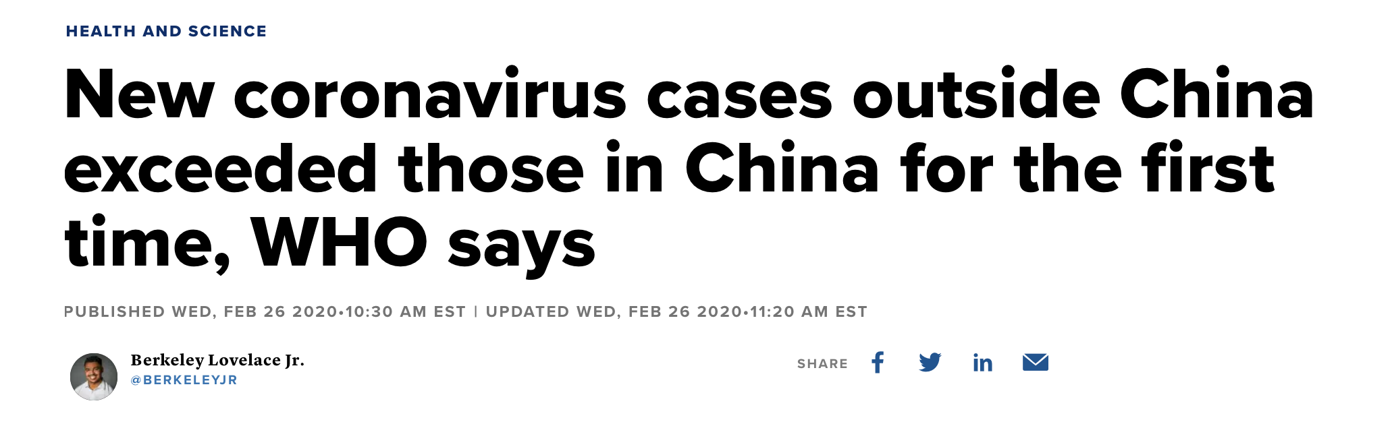
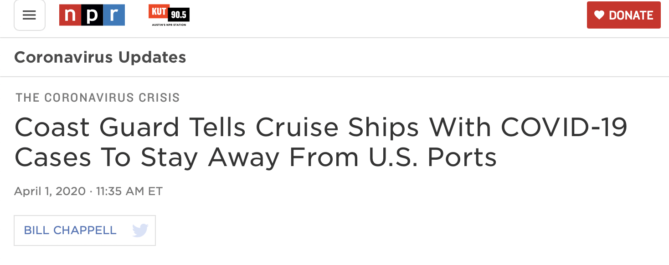
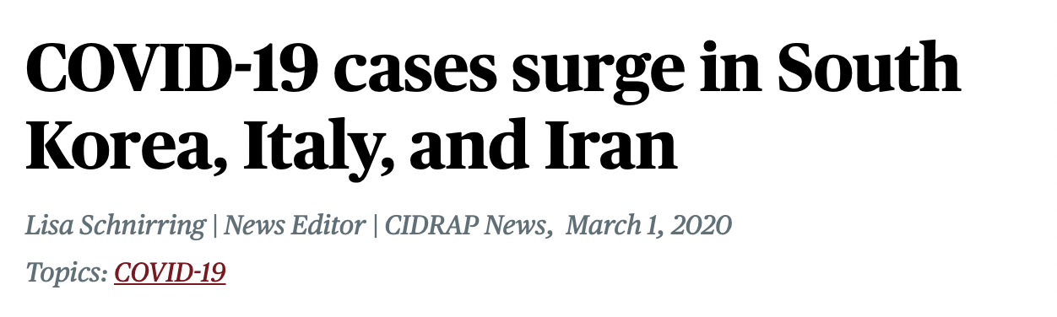
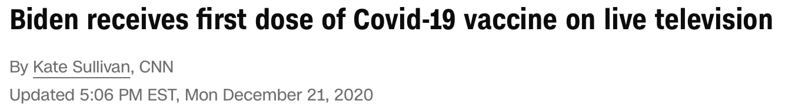
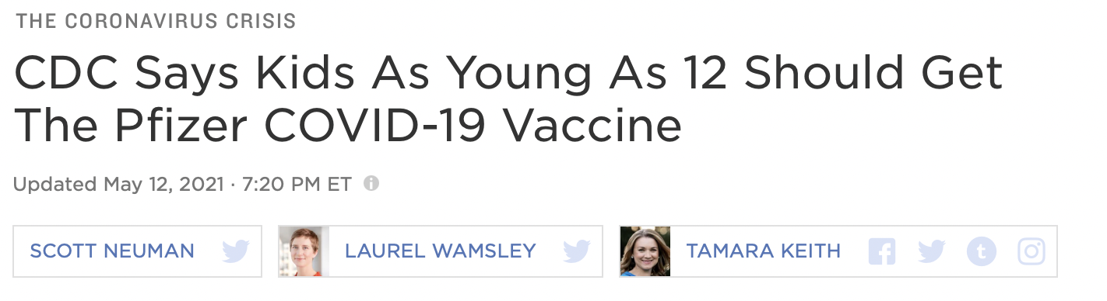
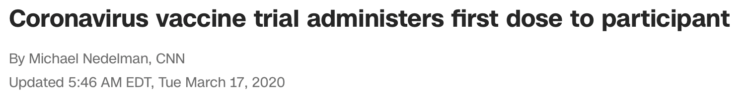
CoVID-19 in the News

Slide 4
Research Question
How do vaccinations across each state compare with total cases across each state in 2021?
Is there a significant correlation between rate of vaccinations and number of total cases by state over time?
Was this the US government's initial strategy?

Slide 5
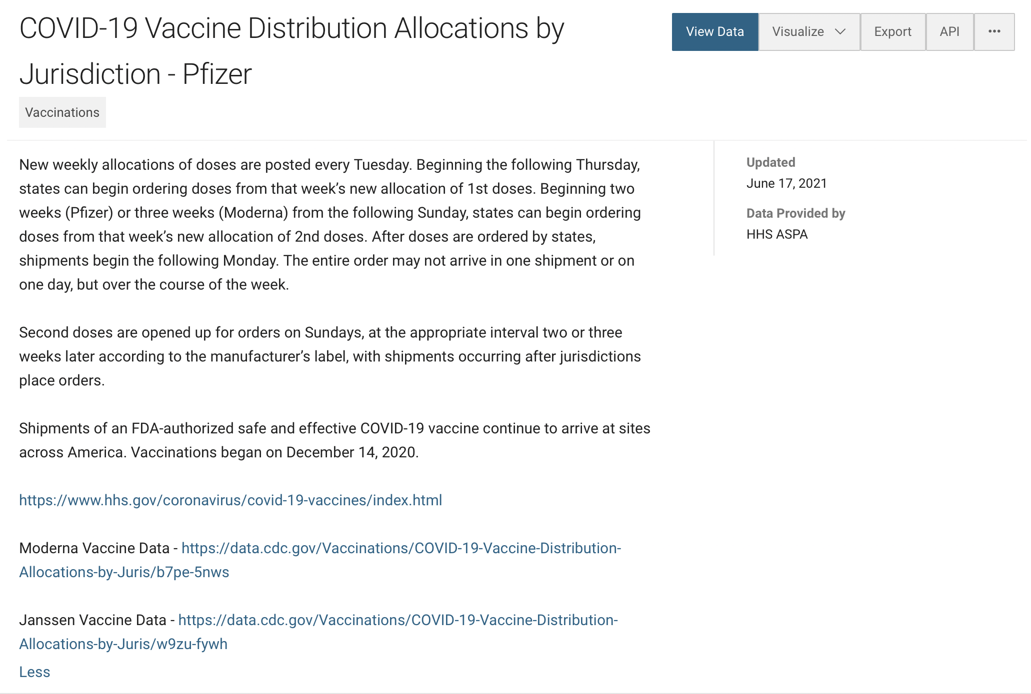
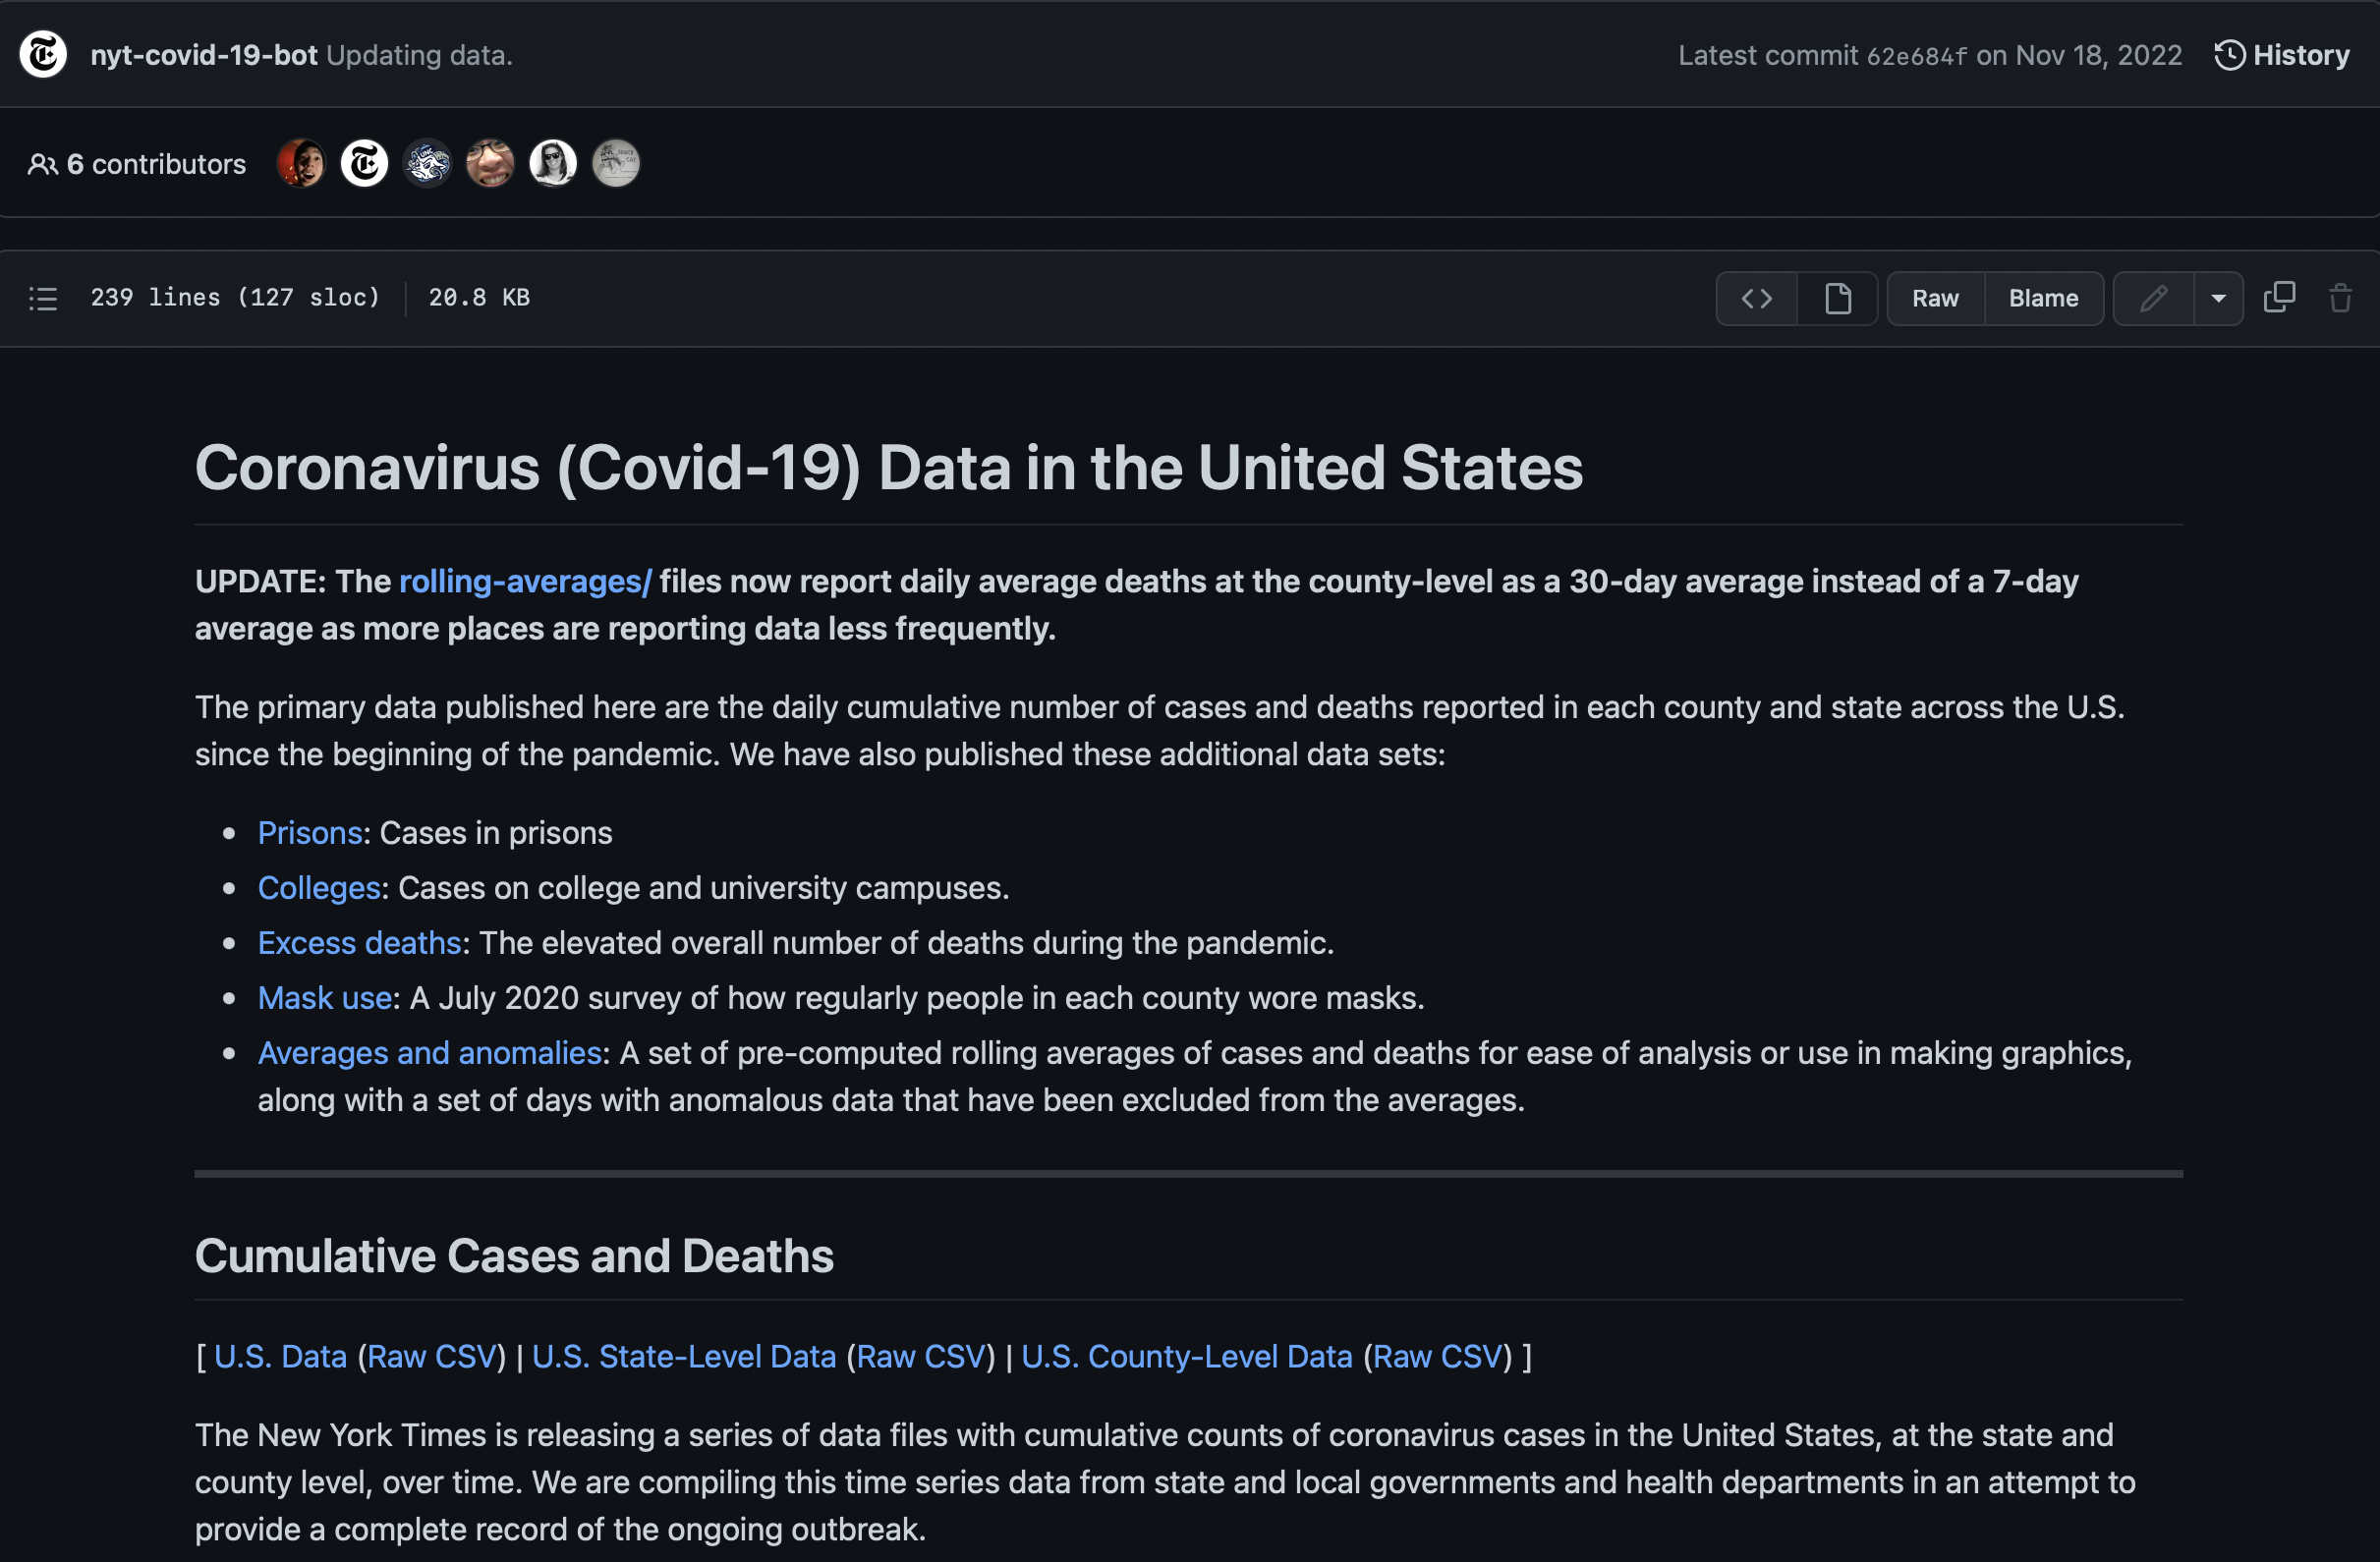
Data Sourcing
Data for vaccines from CDC
Tracks total number of vaccines per type (Moderna, Pfizer, J&J) distributed per week in each state
Pfizer: https://data.cdc.gov/Vaccinations/COVID-19-Vaccine-Distribution-Allocations-by-Juris/saz5-9hgg
Moderna: https://data.cdc.gov/Vaccinations/COVID-19-Vaccine-Distribution-Allocations-by-Juris/b7pe-5nws
Janssen: https://data.cdc.gov/Vaccinations/COVID-19-Vaccine-Distribution-Allocations-by-Juris/w9zu-fywh
Data for cases from New York Times
Tracks number of CoVID-19 cases per state on a weekly basis
https://github.com/nytimes/covid-19-data/blob/master/README.md

Slide 6
Data Clean-up
Starting with data from May 2021, mapped out inoculation of population state-wise, using data from 3 major vaccine manufacturers: Moderna, Pfizer, Janssen
Reversed data order to allow for chronological progression
Summed three data sets for a total vaccine count for each state, while accounting for number of dosage to avoid double-counting
Moderna and Pfizer each needed 2 doses for inoculation, while J&J needed 1 – final dose of M/P were counted to compare
Only added the Moderna and Pfizer second dose numbers to track fully-vaccinated people
Split columns in the raw data to remove redundant data
Code on next slide

Slide 7
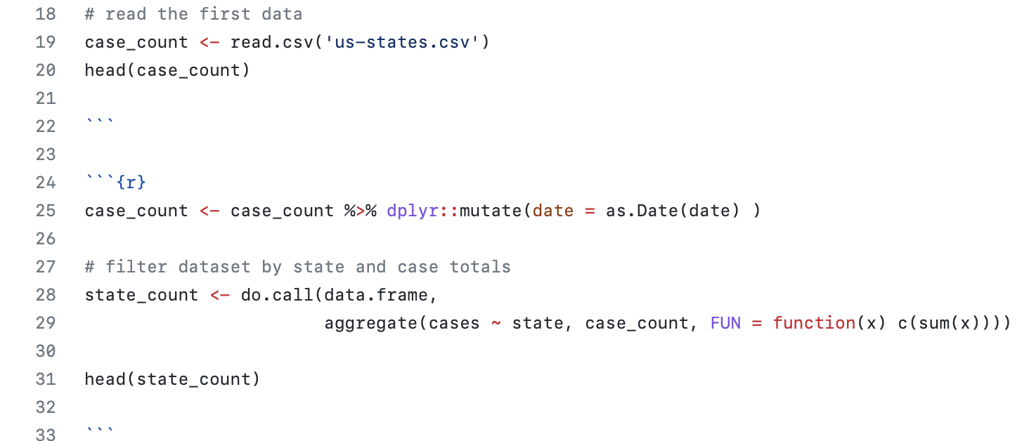
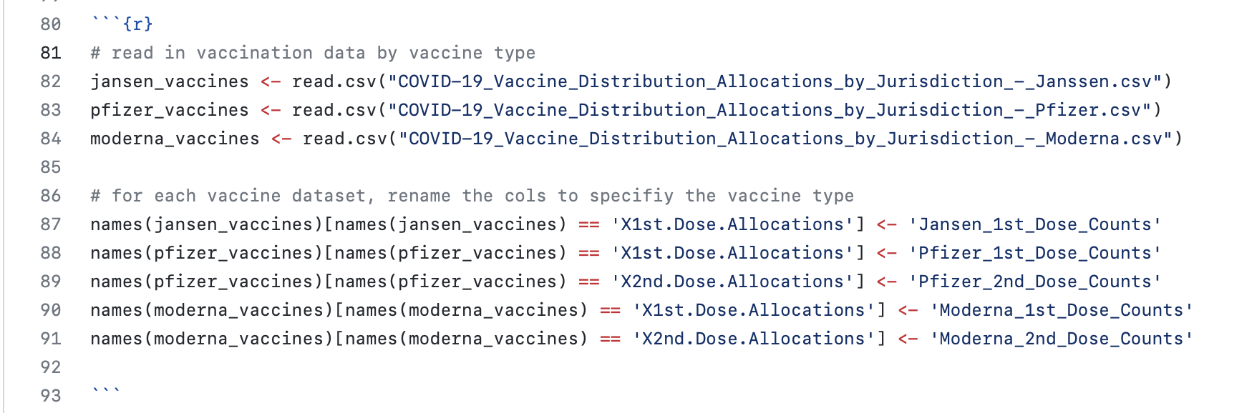
Code to sort through the data for the number of cases. Filtered the data by state and case totals to make comparison against vaccine numbers easier.
Code to read in vaccination .csv files and then assign titles to each column in the data frames.

Slide 8
Functionality
Using a 'mutate' function to add rows for different vaccine manufacturers
Using an 'aggregate' function to generate statistical data for datasets
Geom_point and geom_line for continuous bivariate distribution, plotting vaccine doses against time
Exploring an 'interactive function' to let users input a state name and view specific cases
Within the code, we have included a 'string' (of characters) function to allow individual input for different states.

Slide 9
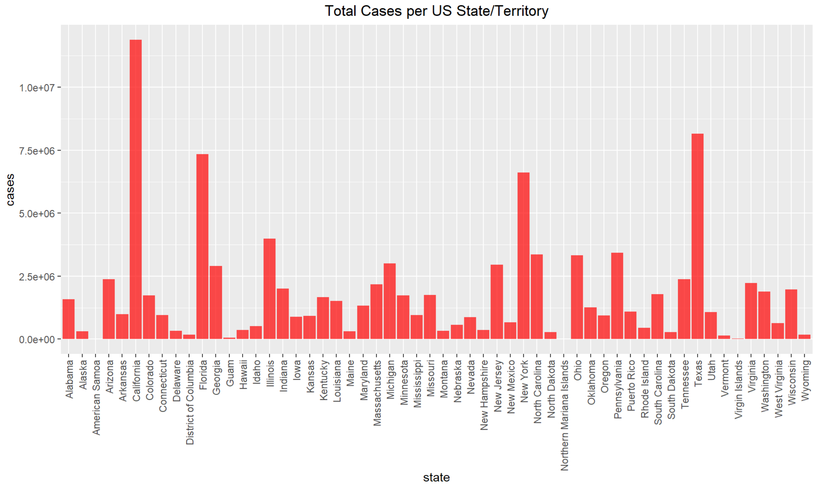
Exploratory Analysis- Cases by State
Figure 1: Bar graph depicting total number of cases for each of the 50 US states and in 3 US districts/territories.
Note: Red will indicate cases, while blue will indicate vaccines.

Slide 10
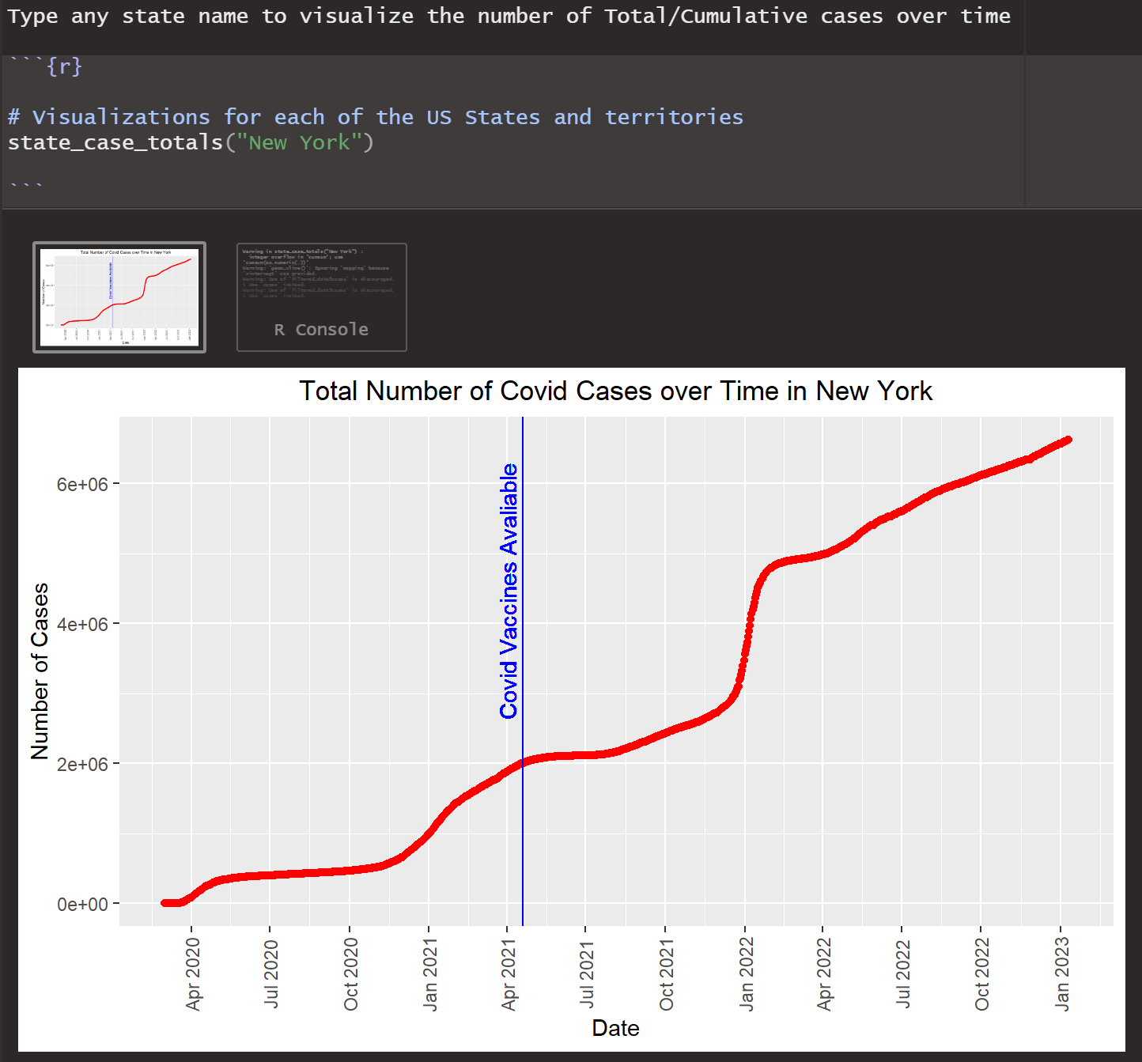
Exploratory Analysis- Cases by State Cont.
"Interactive" plot demo
Can type in name of any state to visualize the total number of cases over time for that specific state
Figure 2: Total number of cases over time for New York. Blue line indicates implementation of CoVID-19 vaccines. Data courtesy of the New York Times.

Slide 11
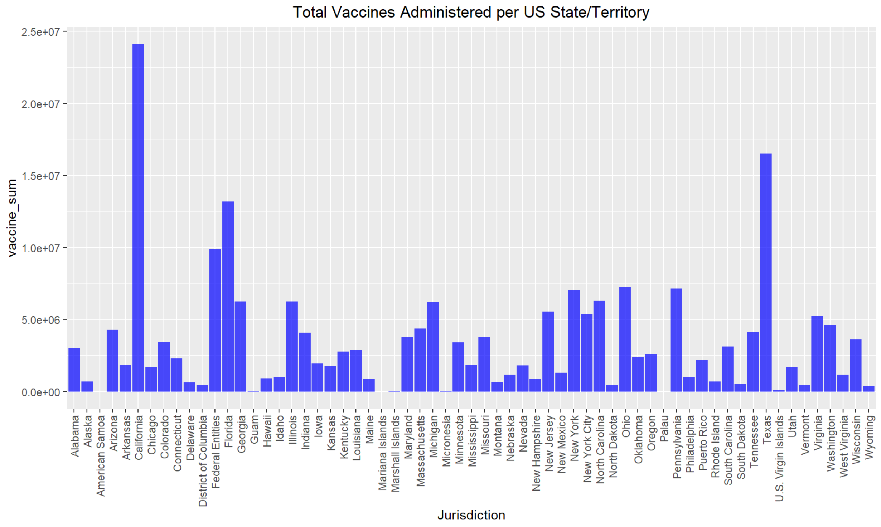
Exploratory Analysis- Vaccinations by State
Figure 3: Total number of vaccines administered in all 50 US states and in 3 US districts/territories. Total vaccine data compiled from summing Pfizer, Moderna, and Janssen data.

Slide 12
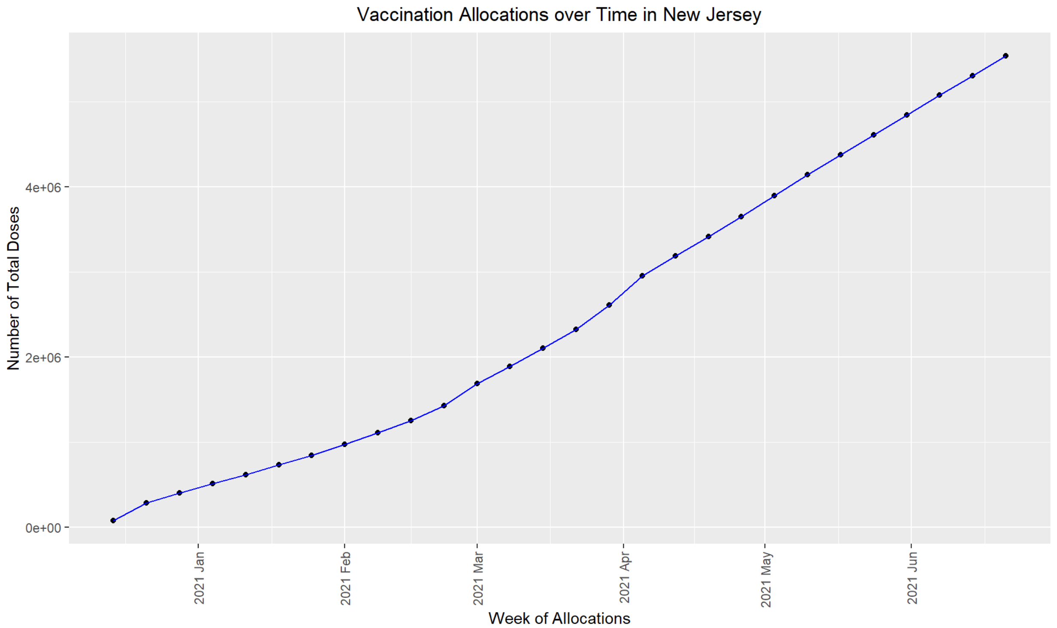
Exploratory Analysis – Vaccinations by State Cont.
Interactive map tracks the number of vaccines distributed over time in 2021
Type state (or district/territory) name into script
Figure 4: Total number of vaccines completely distributed in the state of New Jersey over time in 2021. Data compiled from summing number of 2nd doses administered of Pfizer and Moderna and total number of Janssen vaccines administered.

Slide 13
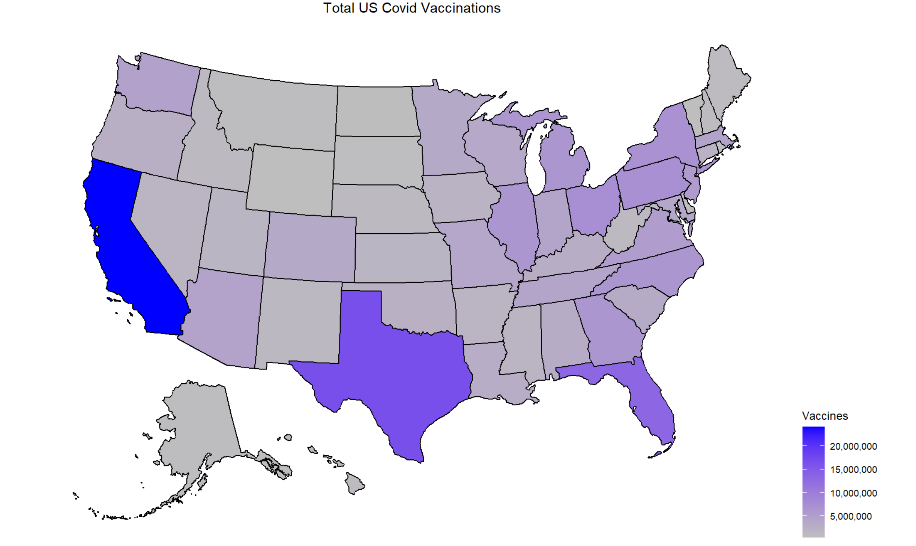
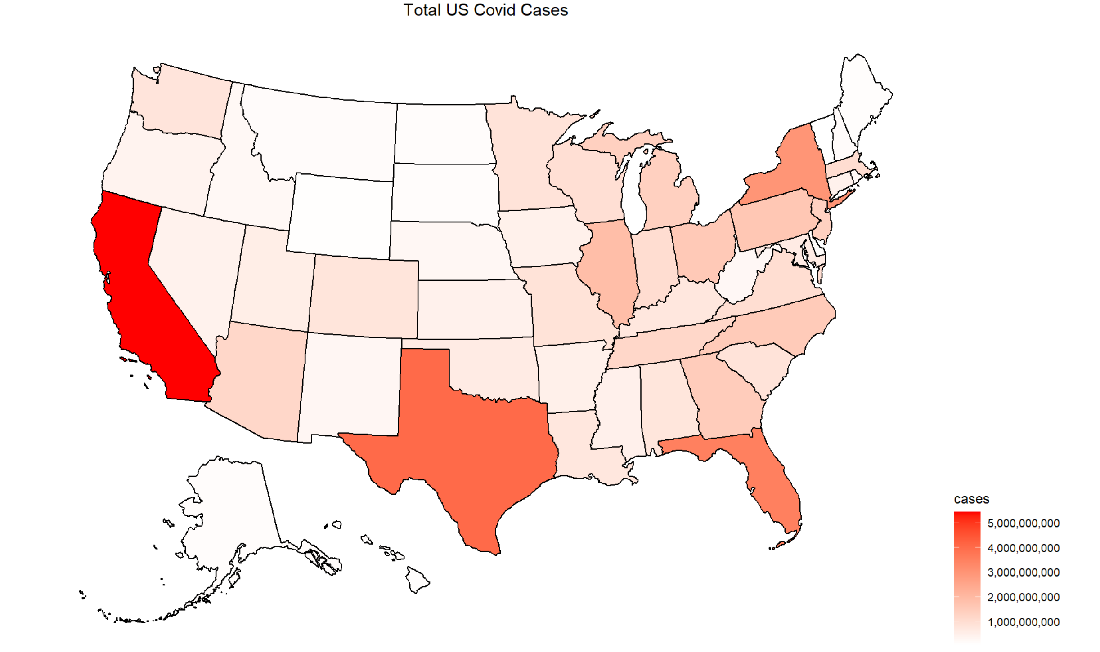
Conclusions
Visualizing relationship between vaccines and new cases
Figure 5: Map displaying total number of vaccines distributed amongst all 50 US states. Refer to legend for color meanings.
Figure 6: Map displaying total number of CoVID-19 cases in all 50 US states. Refer to legend for color meanings.
Notes:
Anshika

Slide 14
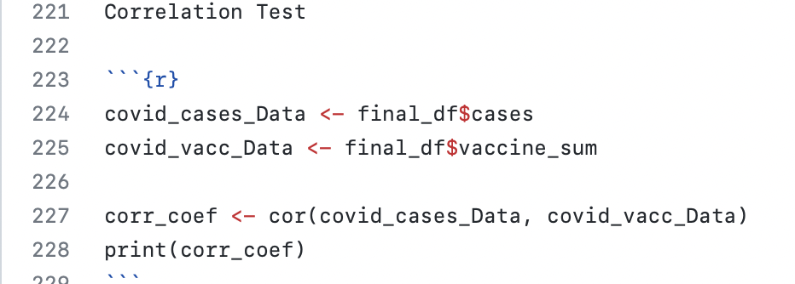
Conclusions Cont.
Studying correlation between vaccines and new cases
Correlation Coefficient: 0.977
There is a strong correlation between number of vaccines distributed and number of CoVID-19 cases
Correlation, not causation
Important to remember that population is a confounding factor and affects number of cases and vaccines distributed
US Government knew social distancing was not a sustainable policy, so rollout of vaccines allowed more freedom in movement, which corresponds to increases of cases with increases of vaccines
Notes:
Anshika

Slide 15
Next Steps
Compare state vaccine rates and CoVID-19 case rates by population density or percentages of state population
Look at how vaccine numbers compare with CoVID-19 death numbers
May not see a "true" correlation between vaccines and case numbers because people can get CoVID-19 even while vaccinated (especially with variants)
Deaths from CoVID-19 against vaccine numbers might show different relationship
Notes:
Anshika

Slide 16
References
https://www.livescience.com/first-case-coronavirus-found.html
https://www.ajmc.com/view/a-timeline-of-covid-19-vaccine-developments-in-2021
https://www.cnbc.com/2020/02/26/new-coronavirus-cases-outside-china-exceeded-those-in-china-for-the-first-time-who-says.html
https://www.npr.org/sections/coronavirus-live-updates/2020/04/01/825205607/coast-guard-tells-cruise-ships-with-covid-19-cases-to-stay-away-from-u-s-ports
https://www.cidrap.umn.edu/covid-19/covid-19-cases-surge-south-korea-italy-and-iran
https://www.cnn.com/2020/03/17/health/coronavirus-vaccine-first-dose-participant/index.html
https://www.cnn.com/2020/12/21/politics/bidens-coronavirus-vaccination/index.html
https://www.npr.org/sections/coronavirus-live-updates/2021/05/12/996185305/federal-panel-recommends-coronavirus-vaccines-for-adolescents-aged-12-15
https://data.cdc.gov/Vaccinations/COVID-19-Vaccine-Distribution-Allocations-by-Juris/saz5-9hgg
https://data.cdc.gov/Vaccinations/COVID-19-Vaccine-Distribution-Allocations-by-Juris/b7pe-5nws
https://data.cdc.gov/Vaccinations/COVID-19-Vaccine-Distribution-Allocations-by-Juris/w9zu-fywh
https://github.com/nytimes/covid-19-data/blob/master/README.md

Slide 17
Github Repo with code
https://github.com/krutalp/Final_Project_Covid_Data

